Slide 1

Book Vista Churn Prediction Models
march 2024

Slide 2
Book Vista Churn Prediction
S U M M A R Y
BOOKVISTA would like to be able to predict which of their subscribers are likely to churn within 90 days of beginning a subscription, so that they can intervene somehow to prevent subscriber losses in the future.
›
2

Slide 3
The Process
Preprocessing
EDA
Feature Engineering/Selection
Data Cleaning.
Data Integration.
Data Transformation.
Data Reduction.
Import all the crucial libraries.
Identifying and handling the missing values.
Handling Outliers in Data Preprocessing
Splitting the dataset
Understanding your variables
Analyzing relationships between variables
Creating visuals
Feature Creation
Transformations
Feature Extraction
Feature Selection

Slide 4
Dataset Info/Sample Dataset
User_train.csv
54,129 Rows
28 Columns
training dataset with demographic and website interaction information about BOOKVISTA users. Every row of this dataset represents a unique user.
User_test.csv
26,662 Rows
27 Columns
testing dataset with demographic and website interaction information about BOOKVISTA users
Orders.csv
527,066 Rows
7 Columns
dataset containing information about each order and additional order placed by the users.
Additions.csv
167,826 Rows
2 Columns
dataset containing information about when users have placed additional orders into their existing subscription.

Slide 5
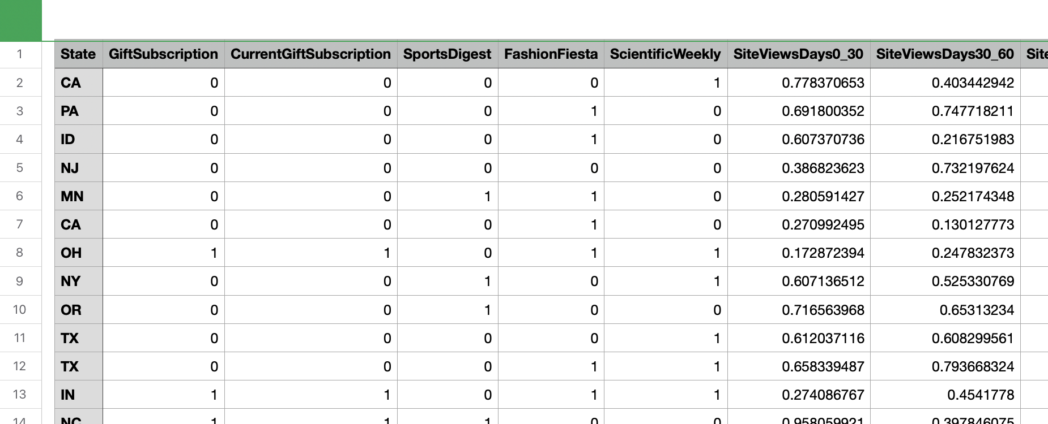
Sample Dataset

Slide 6
Combined Dataset Features Used in Model
1. GiftSubscription
CurrentGiftSubscription
SportsDigest
FashionFiesta
ScientificWeekly
SiteViewsDays0_30
SiteViewsDays30_60
SiteViewsDays60_90
SiteSearchesDays0_30
SiteSearchesDays30_60
SiteSearchesDays60_90
HouseHoldIncome
CTR30
OpenRate30
RejectRate30
CTR30_60
OpenRate30_60'
RejectRate30_60
CTR60_90
OpenRate60_90
RejectRate60_90
Ratings0_90
Age
sumTotalPromotions
sumOrderValue
sumItemvalue
sumNoItems
countTotalPromotions
NumAdditions
lastDateYear
lastDateMonth
CreatedDateYear
CreatedDateMonth

Slide 7
The Model
Logistic regression
A statistical method utilized for binary classification tasks, predicting the probability of an instance belonging to one of two classes.
It models the relationship between independent variables and the probability of the outcome using the logistic function.
Coefficients are estimated to fit a linear decision boundary, separating the classes in feature space.
It's evaluated using metrics like accuracy and AUC, providing interpretable results with straightforward coefficients.
Despite its simplicity, logistic regression is a widely used and effective classification model in various domains.

Slide 8
The Metrics
Evaluation Metrics
Classification Report:
precision recall f1-score support
0 0.56 0.56 0.56 8027
1 0.57 0.57 0.57 8212
Accuracy 0.56 16239
Macro Avg 0.56 0.56 0.56 16239
Weighted Avg 0.56 0.56 0.56 16239

Slide 9
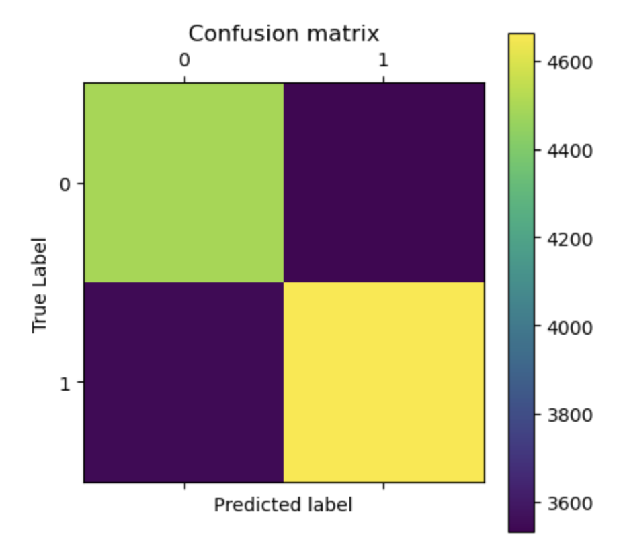
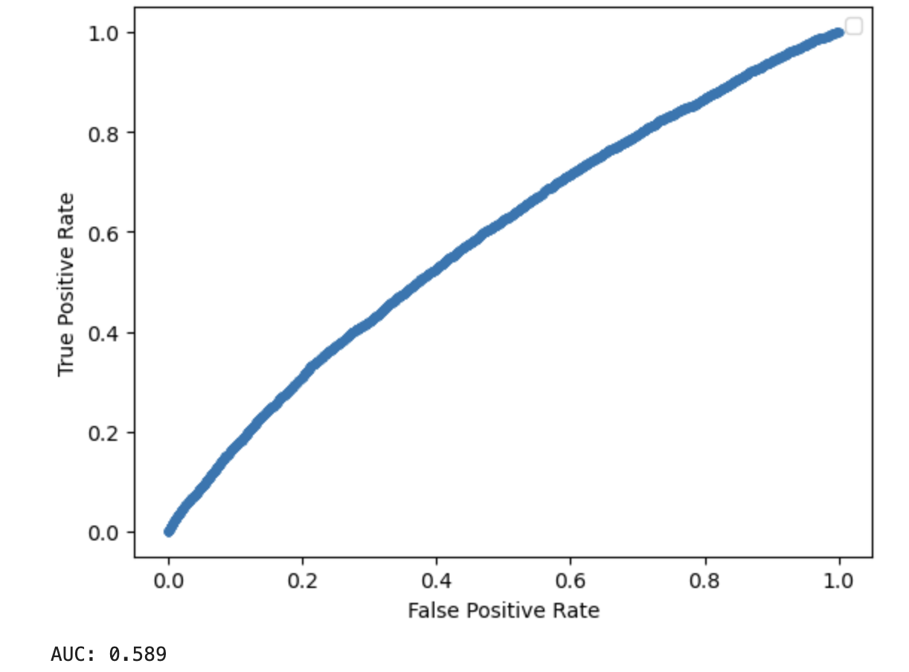
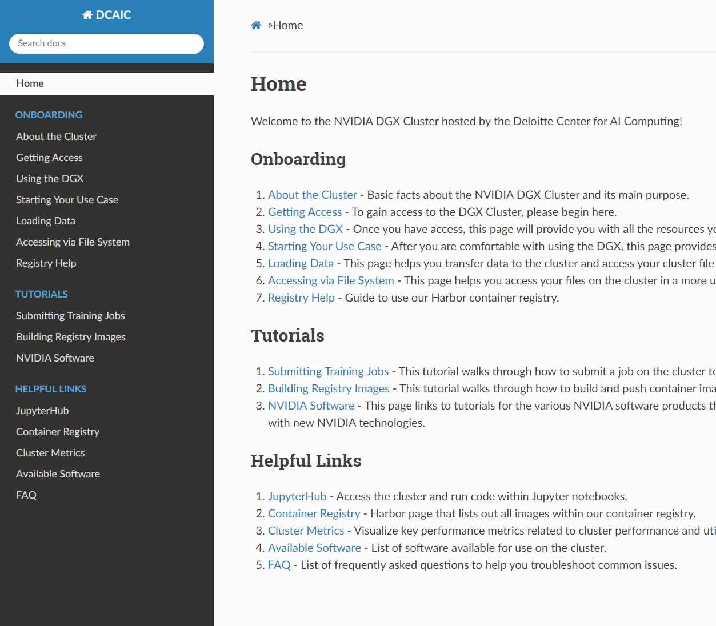
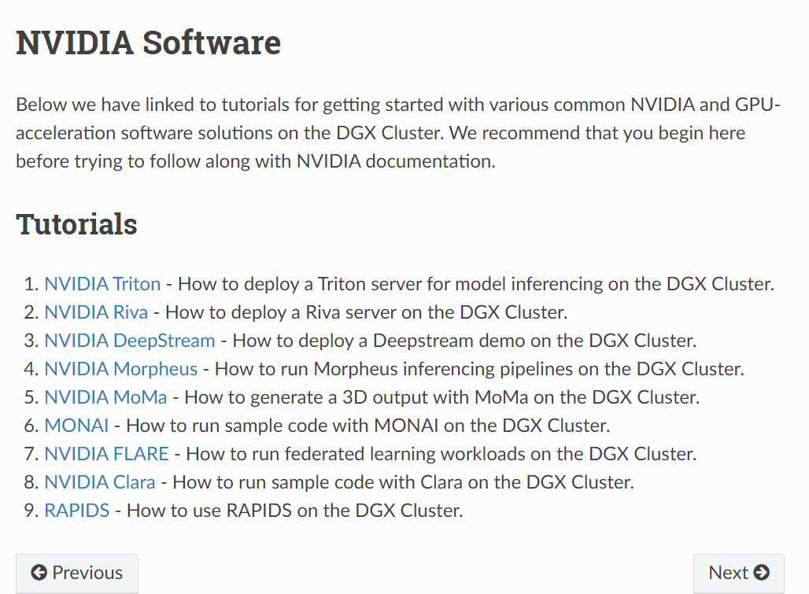
Confusion Matrix and ROC-AUC Curve
Model Evaluation
https://www.dcaic.deloitte.com/docs/
Note: You must be on VPN to access the link.
The documentation covers:
FAQs such as:
How do I request access to the cluster?
Once I have access, how do I get started?
What software is available on the cluster?
How do I load my data?
Self-guided step-by-step Tutorials, including how to deploy/use NVIDIA Software on the cluster
4495
3532
3538
4664

Slide 10
The 100 Customers
BookVista wishes to engage 100 customers based on the models predictions
Top Reasons for pursuing these 100 customers first
Greater than 50 % chance of churn based on model
Highest value customers in terms of money previously spent
42% percent of customers have received no promotion
Only 23% of these customers have received more than 1 promotion

Slide 11
Operationalize
A Step-by-Step Action Plan
Identify predicted churn customers using Logistic Regression model
Collect and Review data on Individual customer product purchase history
Design compelling Promotions tailored to customer preferences offering products similar or complimentary to previously bought items
Send tailored promotions to the customers

Slide 12
Questions?

